Slide 1


SUPREME PETROCHEM LTD
POLYSTYRENE INTO VARIOUS COMPOUNDS

Slide 2








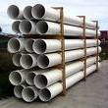
Jointly Promoted By
The Supreme Industries Ltd
R. Raheja Group
    India’s Largest Plastic Processors (Processing approximately 200,000TPA of various Polymers)
    Industrial and Engineering Moulding
    XLPE Films & Products
    Protective Packaging
    Plastic Piping Systems
    Molded Furniture
    18 Plants across India
    Turnover of 420 million US$
    Business Interests :
    Hotels
    Building construction
    Cement
    Media
    Automotive Batteries
    Ceramic Tiles
    Satellite Communication
    Retail Superstores

Slide 3
Supreme Petrochem Ltd (SPL)
INDIA’s largest Polystyrene manufacturing company
Supreme Petrochem made a modest beginning in 1995,with a Polystyrene plant of 66,000 TPA capacity at Nagothane . In a decade SPL has become the undisputed leader in Polystyrene in India with a market share of 50% + .
Exports to over 98 countries worldwide.
  Three lines, one line each dedicated to GPPS and HIPS & one capable of producing GPPS or HIPS depending upon market requirements.
  India’s first and only facility to manufacture XPS Boards with a capacity of 150,000 m3/year capacity.
  Annual Turnover of 350 million US$

Slide 4
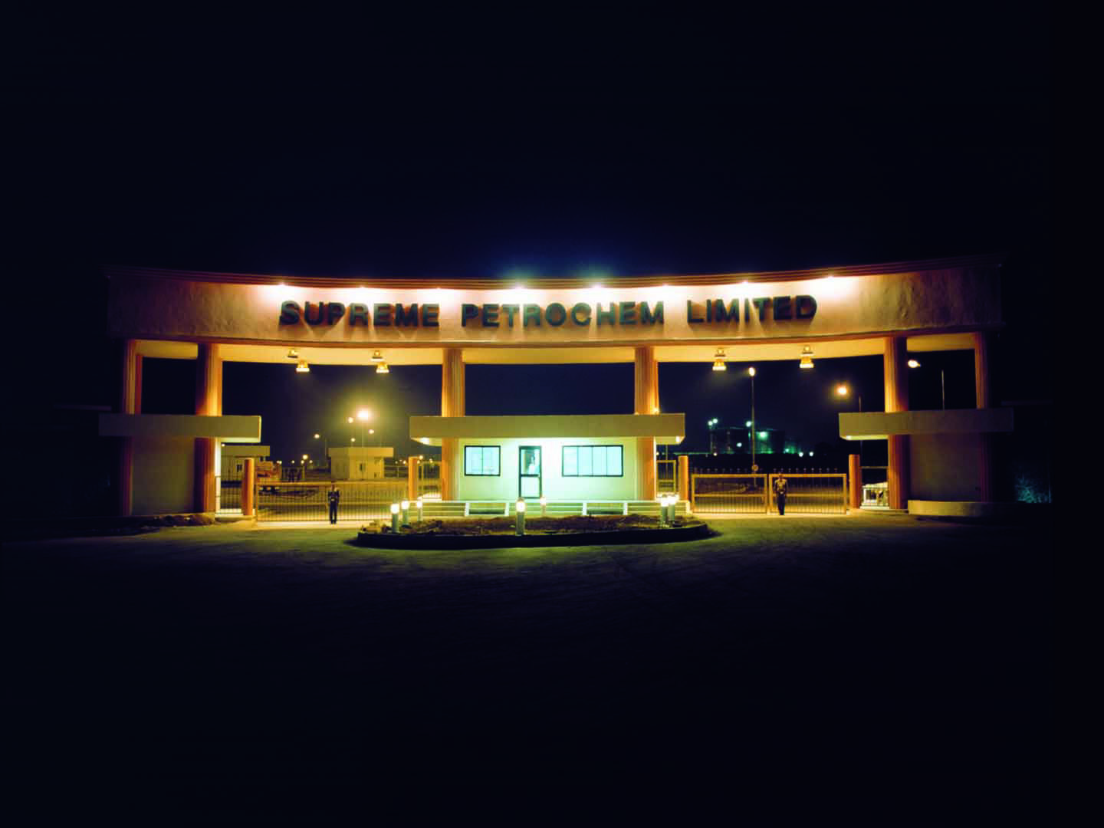
SPL : Plant Location & Facilities
Nagothane Plant –
State of the art manufacturing facility across 350 acres complex at Nagothane, 120 km from Mumbai
Installed capacity ;
    Polystyrene : 272,000 TPA
    Speciality Compounds : 25,000 TPA
    Extruded Polystyrene : 1,50,000 m³
Technology : Erstwhile Huntsman Chemical Corp, USA (Now with Nova Chemicals, Canada) for PS & Ultrabatch, Italy for Additive Masterbatches.
Engineering : ABB Lumus Crest, USA.

Slide 5
SPL : Plant Location & Facilities
Manali Plant:
State of art manufacturing facility in 15 acres at Manali, Chennai
  Installed capacity : 27,000 TPA EPS
  Technology : Shinho Petrochemicals, Korea for EPS

Slide 6
SPL: Location
Delhi
Nagothane (Raigad)
Pune
Manali (EPS Plant)
Automotive Hubs in India
Chennai
SPL Plant
SPL has warehousing facility at Delhi, Chennai & Bangalore

Slide 7

SPL: Quality Benchmark
ISO 9001:2008 for Quality Management System.
ISO/TS 16949 certified by M/s BVQI
ISO 14001 :2004 for Environment Management System.
OHSAS 18001:2007 for HSE Management System.
5 star Rating on Health & Safety Management System by British Safety Council.
Signatory to 'Responsible Care' initiative in India.
Implementing 'Six Sigma' programs for enhancing customer satisfaction.
UL rating as per UL94 V0 & V2 rating for FR HIPS and several grades.
Food Contact Approval as per EU requirements and compliance with US
FDA requirements.
CFTRI, India - Qualification for food packaging products.

Slide 8
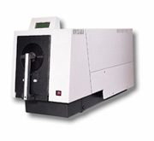
SPL: Testing facility
Melt Flow Index Tester-Dynisco/kayness
Tensile Tester-Lloyd LR5K
Izod/Charpy impact Tester-ATS FAR/Ray Ran
HDT & Vicat tester-ATS FAR
Gas Chromatography-Chemito 8610
HPLC -Metrohm
Particle size analyzer-Master Sizer
Gel Permeation Chromatography-Hitachi D2520
FTIR-Impact 400D
Colour Spectrophotometer-Gretag Macbeth
Moisture analyzer-Mettler Toledo LJ16
Engel and L&T Demag Injection Molding machine

Slide 9
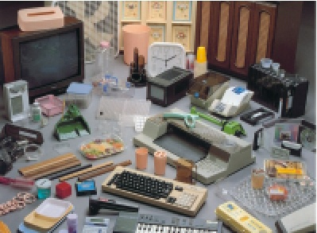
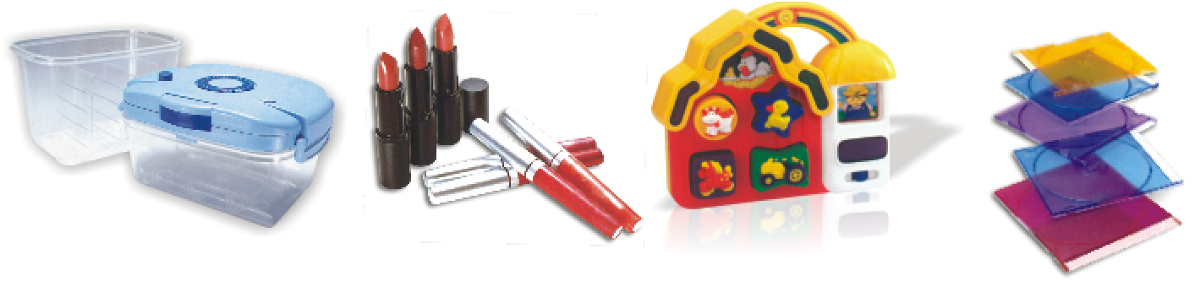
SPL: Polystyrene
SPL offers a wide range of
  General Purpose Polystyrene (GPPS)
  High Impact Polystyrene (HIPS)
for Injection , Extrusion ,Thermoforming and Blow molding applications with combinations of toughness, rigidity, HDT and flow behavior.
SPL can supply PS with < 500 ppm of residual Styrene monomer, and ethyl benzene... a major requirement for food contact applications in EU and U.S.A. market.

Slide 10
SPL: Polystyrene
Refrigerator
Television, A/C
Water Purifier
Food Service Ware
HIPS
GPPS
Packaging
Stationery
Water Purifier
House ware
Application
of PS
EPS
Food Packaging
Building Construction
Block Moulding
XPS
Green Building
Cold Storage

Slide 11
  SPL: Specialty Polymers (SPS)
  SPS Product Portfolio
  Pre Coloured Polystyrene
  Flame Retardant Polystyrene
  Toughened Polystyrene
  Masterbatches
  Polyolefinic Compounds

Slide 12
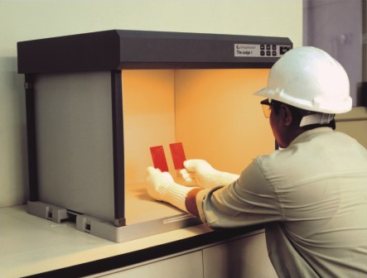
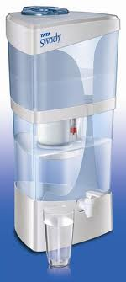
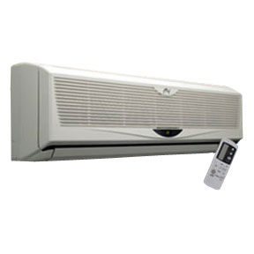
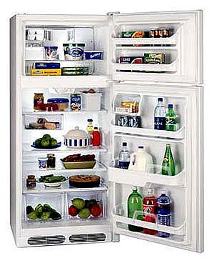
  SPL: Specialty Polymers (SPS)
Pre Coloured Polystyrene
Pre Coloured High Gloss HIPS for Washing machines, AC, Refrigerators, Water Purifiers and other appliances
Pre Coloured HIPS for Printer parts, High end Toys, Medical Diagnostic kits etc
Pre Coloured ESCR HIPS for Refrigerator liners
Wide range of colours complying with ROHS, regulations for Food, Cosmetics, Toys etc
Both UV stabilised and non UV grades available
Very strong presence with globally renowned manufacturers of Appliances

Slide 13
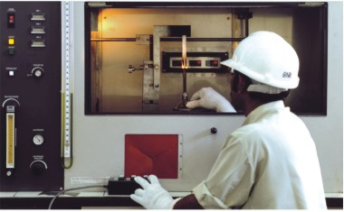
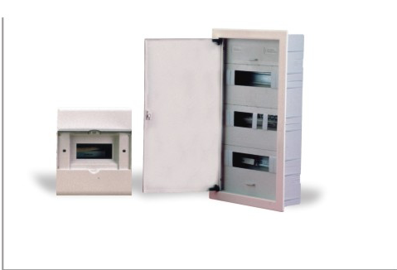
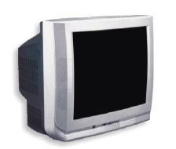
  SPL: Specialty Polymers (SPS)
Flame Retardant Polystyrene
Suitable for applications where fire resistance and safety are of concern
Range of UL 94 approved, ROHS & REACH compliant V 0 & V 2 grades in natural and pre coloured shades
Recommended for TV back covers, Electrical appliances, Business machines, Electrical distribution boxes etc.

Slide 14
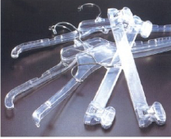
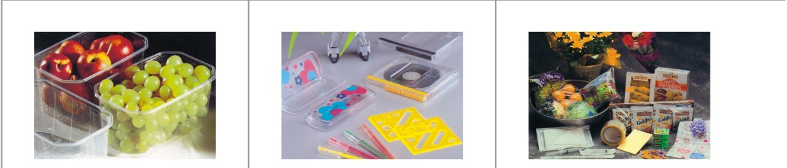
  SPL: Specialty Polymers (SPS)
Toughened Polystyrene
SPL’s Toughened Polystyrene grades offer high clarity with improved flexibility making them suitable for;
  Hangers
  Food service ware
  Toys
  Medical devices

Slide 15
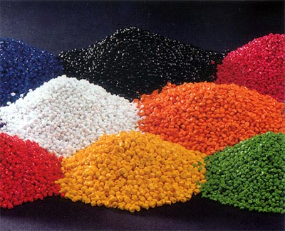
  SPL: Specialty Polymers (SPS)
Masterbatches
Technology Partner : Ultrabatch s. r. l, Italy
Wide range of Masterbatch for diverse applications like injection moulding, extrusion and thermoforming.
Product range includes:
  Colour Masterbatches
  Specialty Masterbatches
  Anti Fibrillating Masterbatch

Slide 16
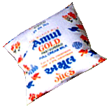
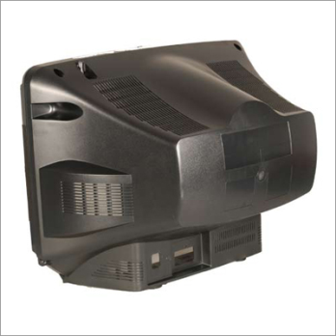
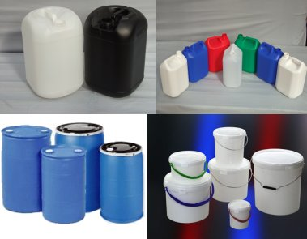
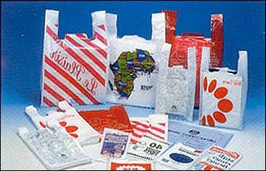

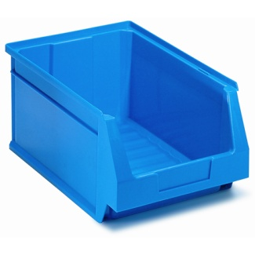
  SPL: Specialty Polymers (SPS)
  Colour Masterbatches
White Masterbatches
  Latest generation PE & PS based White Masterbatch with TiO2
  loading of 40 to 70%
Grey Masterbatches
  Standard grades for appliances /electronic industry
Green Masterbatches
  Specially developed PP based Masterbatch for PPRC pipes & fittings.
Blue Masterbatches
  Blue Masterbatch for Tarpaulins, Material Handling Crate, HDPE Barrels

Slide 17
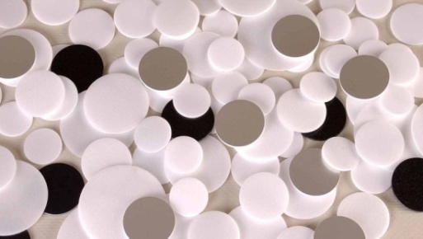
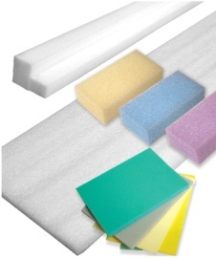
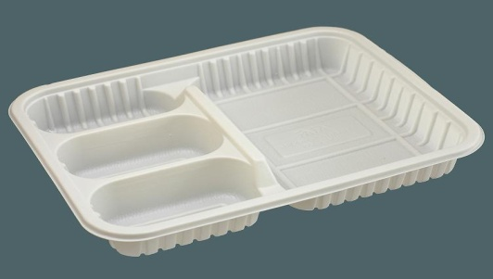
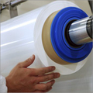
  SPL: Specialty Polymers (SPS)
Specialty Masterbatches
Nucleating Masterbatches
  Specially developed PS based Masterbatch for homogeneous foaming in PS and PE sheets
Additive Masterbatch
  Improves the strength of disposables & minimizes breakages in HIPS
Optical Brightener
  Optical Brightener for PE/PS foam, Multilayer and monolayer films, Injection & Blow molded articles.

Slide 18
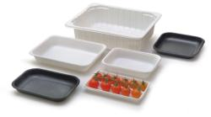
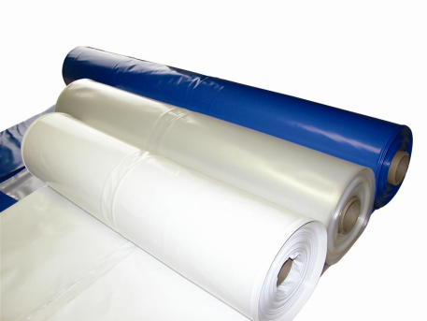
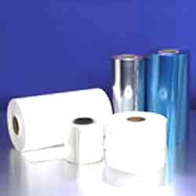
  SPL: Specialty Polymers (SPS)
Productive Masterbatch
  Specially designed for PP thermoforming for improving productivity
Antiblock Masterbatches
  Polyolefin based masterbatch for monolayer and multilayer films to remove blocking between two layers of films.
Slip Additive
  Slip additive for Multilayer films and other various application

Slide 19
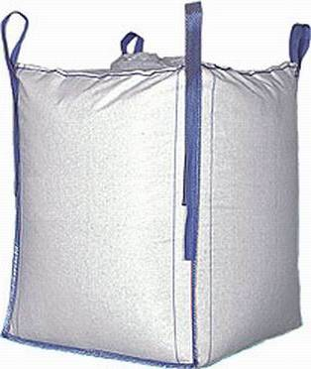
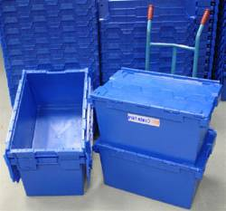

  SPL: Specialty Polymers (SPS)
UV Masterbatches
  PE and PP based masterbatches with active Content of 10 % & 20%
  - FIBC,Woven Sack, Green House Films, Injection molded Container.
Anti fibrillating Filler Masterbatch
Talc Filled Masterbatch for
  - HMHDPE bags & liners , Leno bags etc.
Calcium Filled Masterbatch for
- Shopping bags, FIBC, woven sack etc.

Slide 20

  SPL: POLYOLEFINIC COMPOUNDS

Slide 21
  SPL: POLYOLEFINIC COMPOUNDS
Supreme offers a range of Polyolefinic Compounds which are produced
by “melt blending process” in order to suit specific end use requirements.
State of the art compounding and colouring facility
Our well equipped product development centre, with computerized Colour
matching capabilities, facility for FR testing as per UL Standards, lab
scale processing equipment and more, is the driving force behind new
product development.

Slide 22
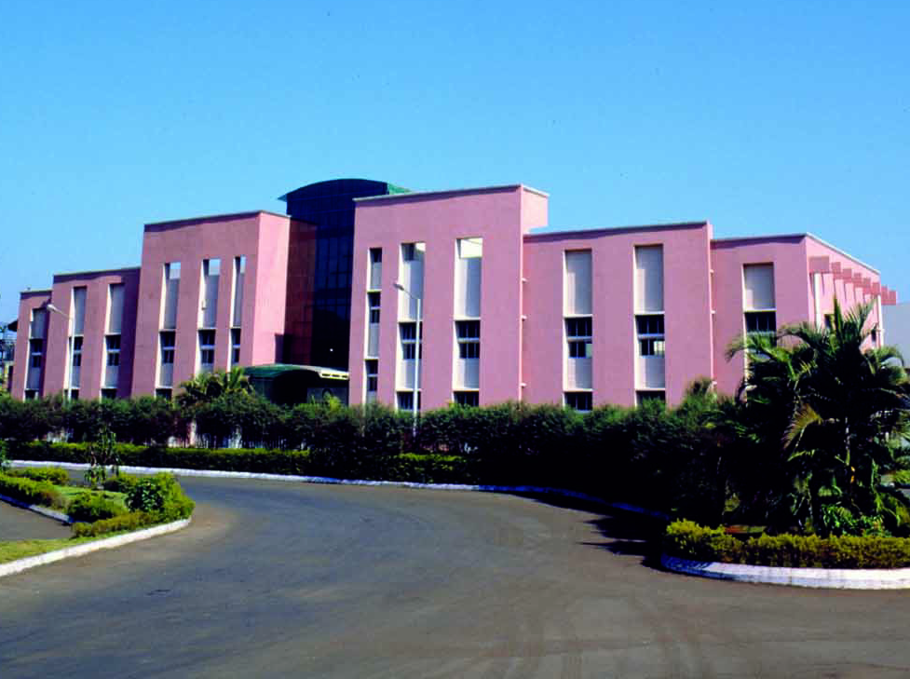
  SPL:POLYOLEFINIC COMPOUNDS
Supreme offers customized PP Compounds with consistent quality.
Product range include,
  Mineral reinforced
  Glass Fiber reinforced
  Elastomer reinforced
  Impact modified
  Flame retardant
  Coloured PP
These cater to diverse market segments including Automotive, Appliances, E&Es & Telecommunication.

Slide 23
Applications
  SPL: POLYOLEFINIC COMPOUNDS
Automotive
Appliances
PP Compounds
Exterior
Interior
Under The Bonnet
E & E’s

Slide 24



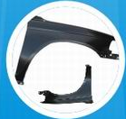
  SPL: POLYOLEFINIC COMPOUNDS
Automotive: Exterior
Bumper System
  Bumpers
  Bumper Fascia
  Bumper Grill
  Front and Rear protectors
Other Exterior Parts
  Valance cover
  Body Side Mouldings
  Fenders
  Fender Liners
  Mirror Housings
  Wheel Arches
  Wheel Guard and trims
  Outer claddings
  Eye Brows
  Mud Guards
  Foot Rest

Slide 25
  SPL: POLYOLEFINIC COMPOUNDS
Automotive: Exterior
Requirements
  High flow
  Good process-ability
  No surface defects
  Good paint-ability
  Good dimensional stability
  High resistance to UV
  High impact strength at low temperatures
SPL Grades
    SPEXP88 SPEXP90 SPEXP123
    SPEXP118 SPEXP157

Slide 26


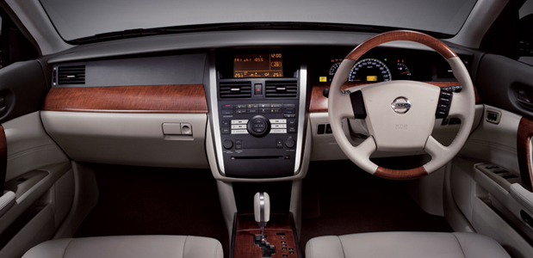
  SPL: POLYOLEFINIC COMPOUNDS
Automotive: Interior
Instrument Panel System
  I.P. /Dashboard
  I.P. Child Parts
  Glove Box
  Outer Lid
  Nascell Covers
  Steering Column Covers
  Nozzle Defroster
  Instrument Cluster

Slide 27


  SPL: POLYOLEFINIC COMPOUNDS
          Automotive: Interior
          Trims and Consoles
                Door Trims
                Pillar trims
                CTR Trims
                Consoles
                Trim Components
Other Interior Parts
    Scuff Plates
    Armrest
    Seating System Parts

Slide 28
  SPL: POLYOLEFINIC COMPOUNDS
Automotive: Interior
Requirements
  Good scratch-resistance
  Low smell
  Low emission
  Medium to high impact
  Good dimensional stability
  High flow
  Low gloss
  Sound-dampening
SPL Grades
    SPEXP85 SPEXP93 SPEXP108
    SPEXP125 SPEXP130

Slide 29


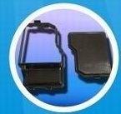
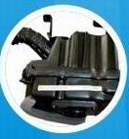
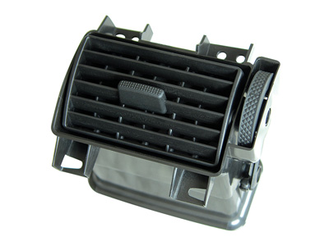
Automotive: Under The Bonnet
  SPL: POLYOLEFINIC COMPOUNDS
  HVAC Components
  Timer belt cover
  Engine encapsulation
  Air Filter / Air filter assembly

Slide 30
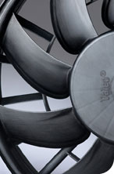
  SPL: POLYOLEFINIC COMPOUNDS
Automotive: Under The Bonnet
Main requirements
Stiffness
High service temperature
Long term thermal stability
Processability
SPL Grades
SPEXP106 SPEXP133 SPEXP156
SPEXP110 SPEXP166

Slide 31

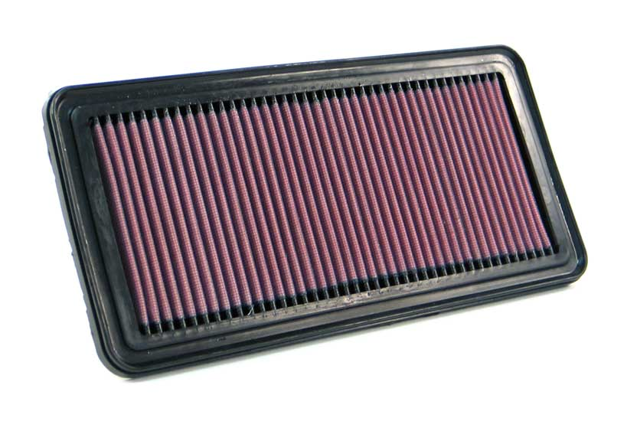
  SPL: POLYOLEFINIC COMPOUNDS
  Two Wheeler
  Battery Containers (VRLA)
  Air Filter / Air filter assembly
SPL Grades
SPEXP 166 / SPEXP 105

Slide 32
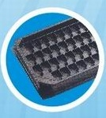


  SPL: POLYOLEFINIC COMPOUNDS
  Appliances
    A.C. grills
    A.C. shrouds
    Dip tray
    Cooler tank
    Room Heater
    Refrigerator base
    Washing machine parts
    W.M. Spin Tub
    Iron Housing
SPL Grades
SPEXP89 SPEXP97 SPEXP139
SPEXP142 SPEXP133

Slide 33
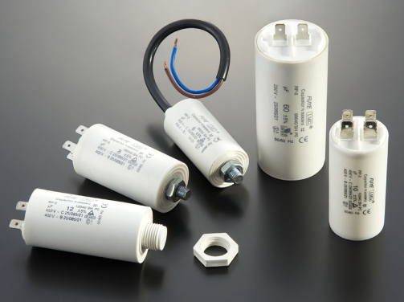
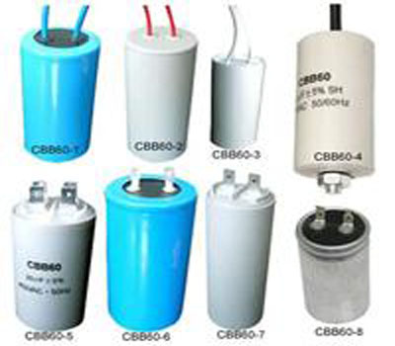
  SPL: POLYOLEFINIC COMPOUNDS
E & E’s
Range of UL 94 approved, ROHS & REACH compliant V 0 & V 2 Polypropylene grades in natural and pre coloured shades
Capacitor canisters
Electrical enclosures
Storage battery containers
Electrical distribution components,
Fuse carriers, enclosures
Domestic appliance housing

Slide 34
  Expandable Polystyrene(EPS)
Current Capacity of 27,000 TPA at Manali, Chennai plant designed mainly to cater to South Indian market requirements.
A new Plant of 24,000 TPA is under commissioning at our existing Petrochemical complex in Nagothane for catering West/North India requirment.
Grades available for protective packaging and Insulation applications.
Process Technology License and Product Off Take venture agreement signed with M/s. Nova Chemicals for CUP GRADE EPS.
EPS Cup grade Capacity of 27,000 TPA , product to be available by Q2 2011.
Total EPS Capacity would be 78,000 TPA by Q2 2011.

Slide 35
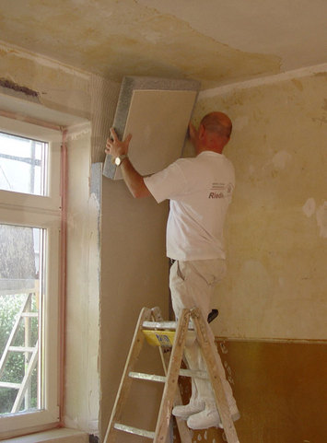


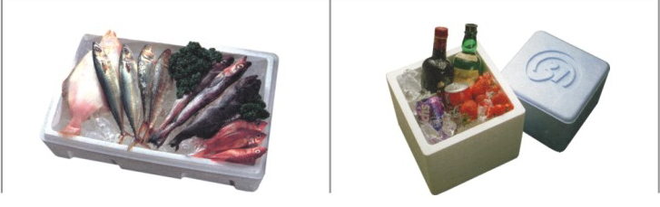
  EPS Applications
Grapes Packaging
Wall Insulation
Insulated Concrete Foam
Fish Boxes
Wine Packaging

Slide 36

  Extruded Polystyrene(XPS)
SPL has forward integrated into manufacturing of XPS ( Extruded Polystyrene Insulation) Boards
Current capacity is 150,000 cubic meter, which will be expanded by 4 times in the next 5 years.
Currently, SPL is only producer of XPS Boards in INDIA.
XPS foam is a premiere insulating material for commercial, industrial and residential structures, due to it’s excellent properties such as :
Excellent compressive strength
Resistance to moisture
Imperviousness to rot, biological growth and corrosion
XPS Boards manufactured by SPL are marketed under “ “ Brand

Slide 37
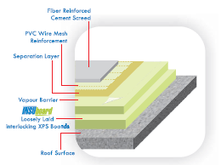

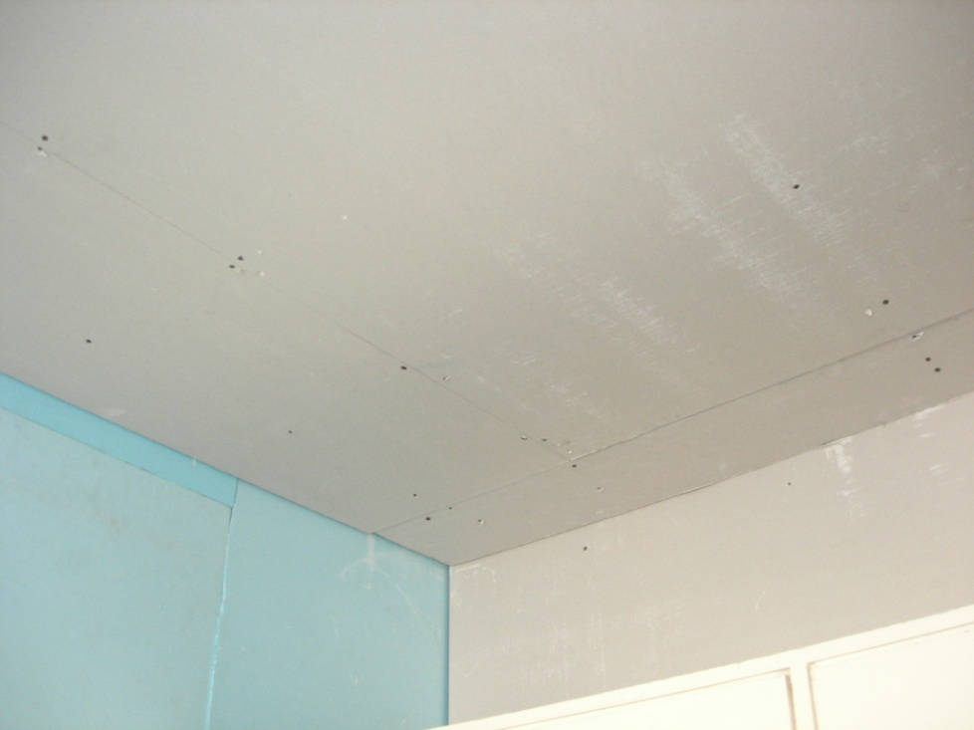
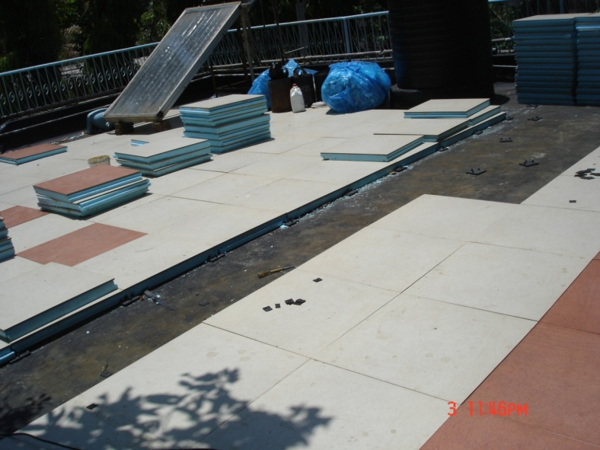
  XPS Application-Roof insulation

Slide 38
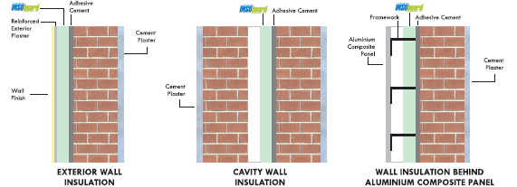
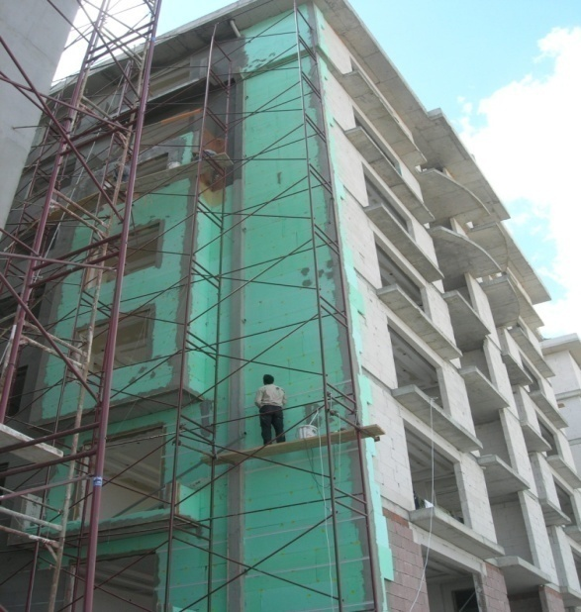
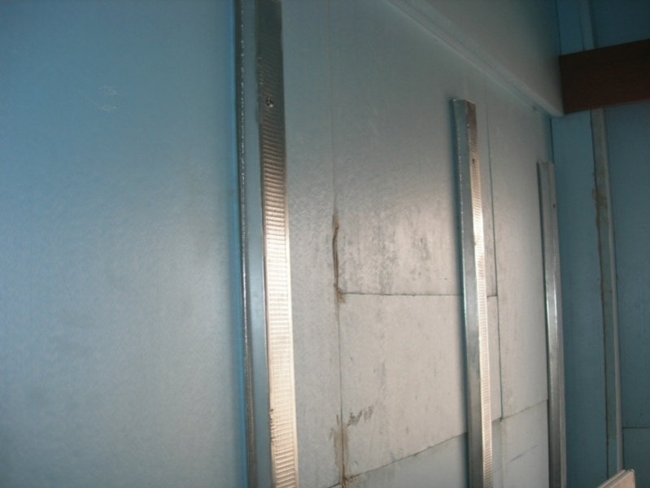
  XPS Application- Wall Insulation

Slide 39

THANK Y U

